Slide 1
Weekly meeting 5
Shengya Guo, CR/AVS3, 24.07.2024

Slide 2
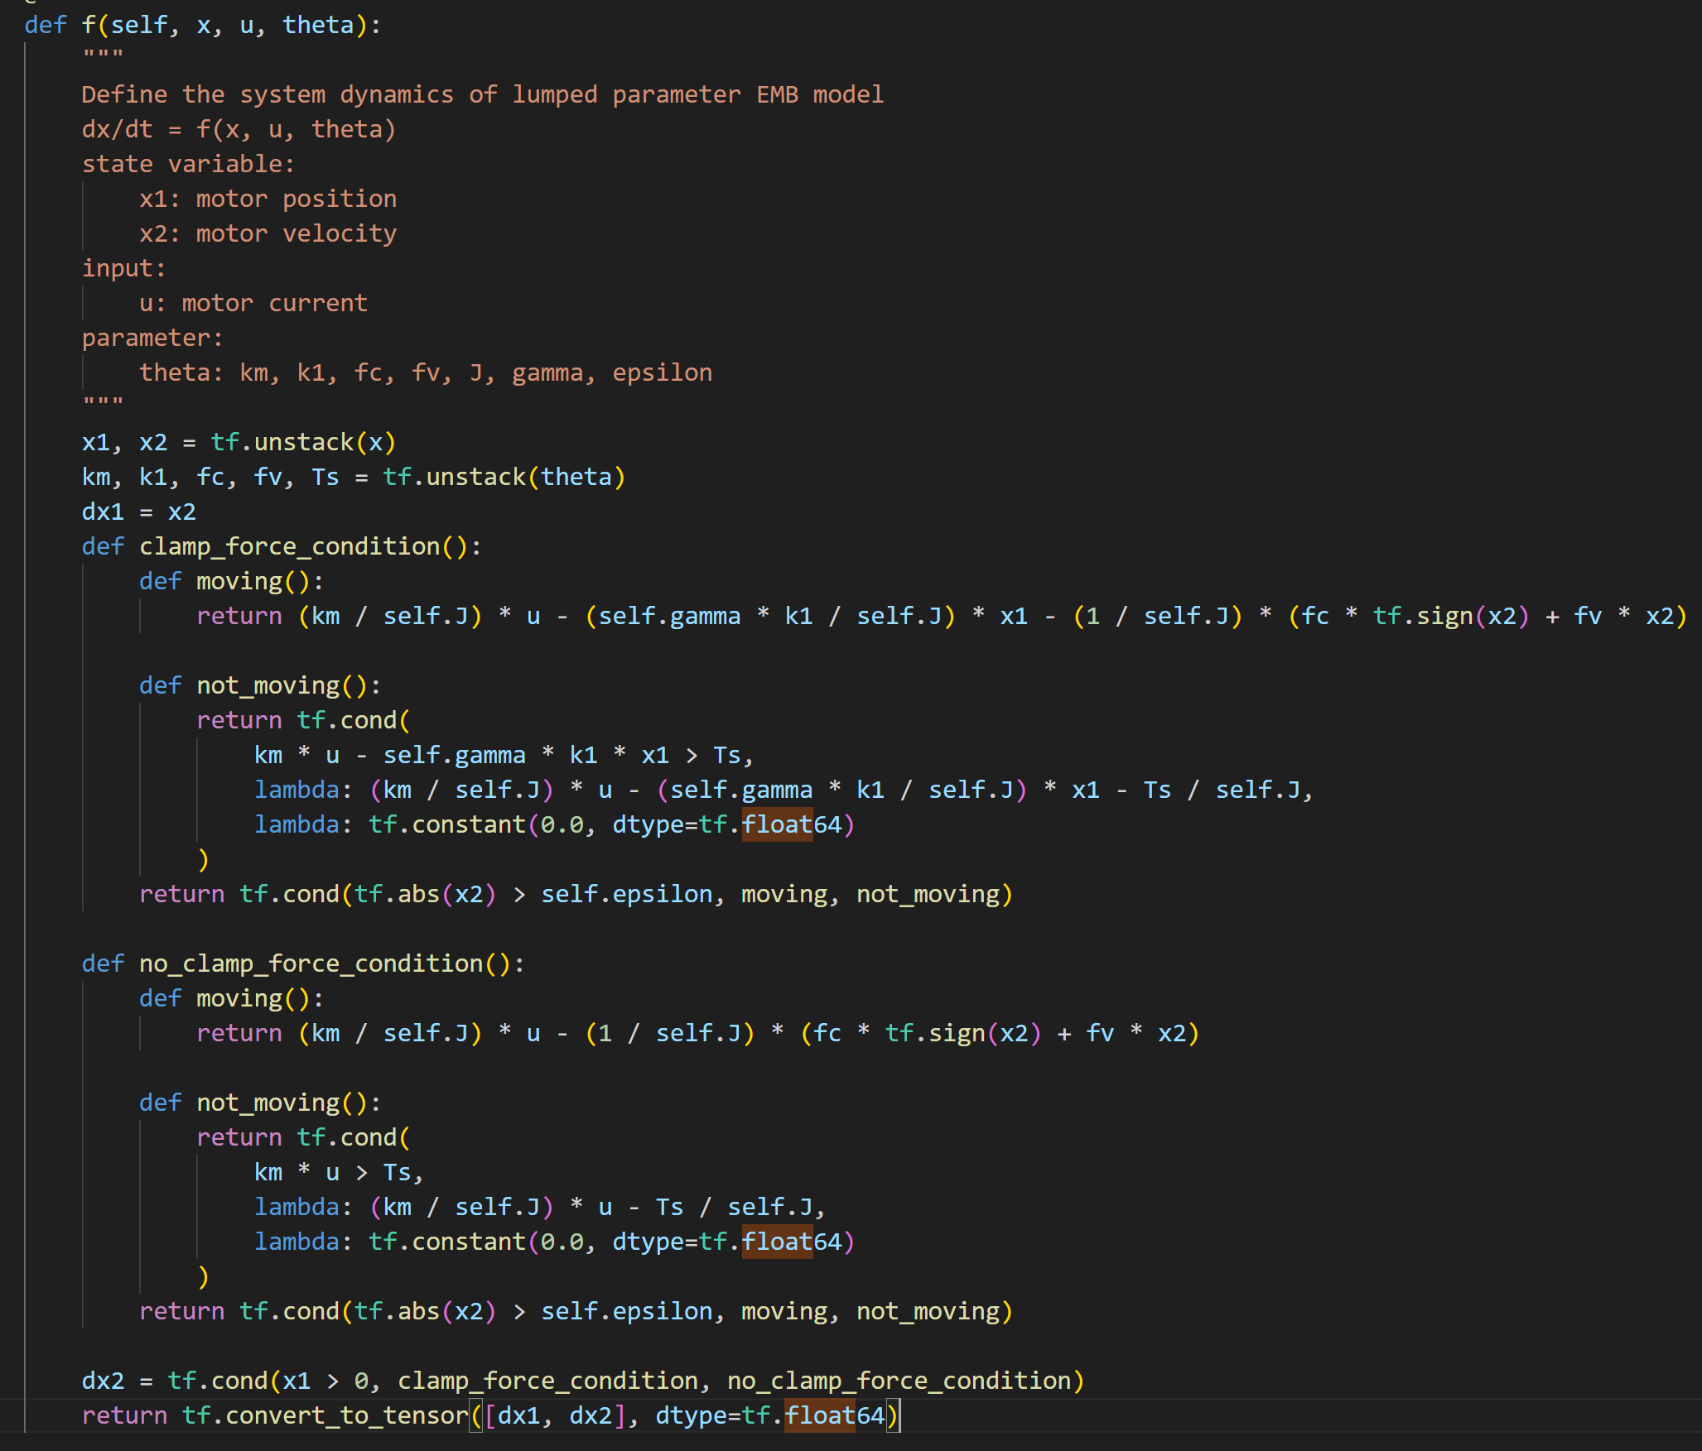
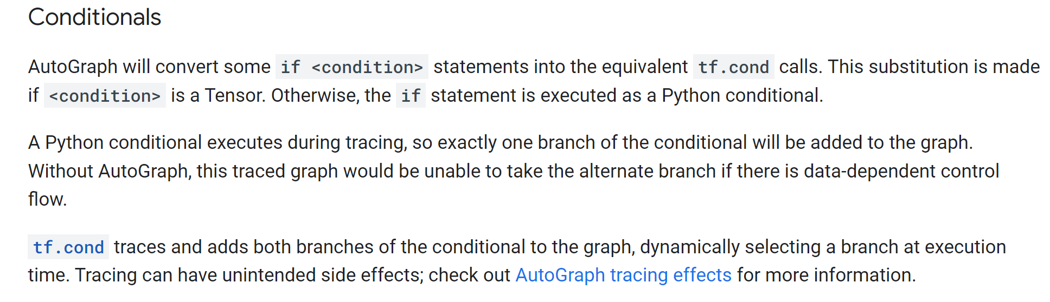
Running time acceleration with AutoGraph

Slide 3
Running time acceleration with AutoGraph
By add @tf.function by both f() and jacobian() and rewrite f() function in the right form, reduce the running time from 151s to 4.8s.
For more calculation precise, all data running and storage in float64
Its works with both if-else function and minmax function.

Slide 4
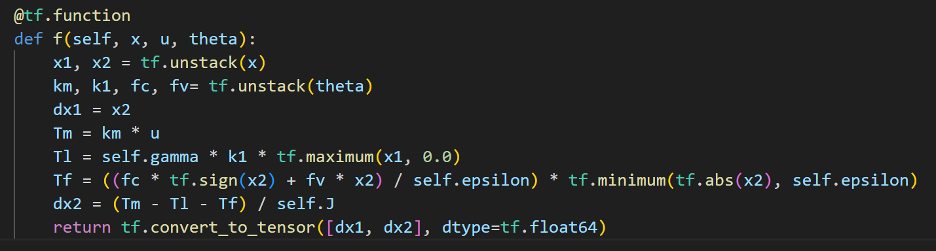
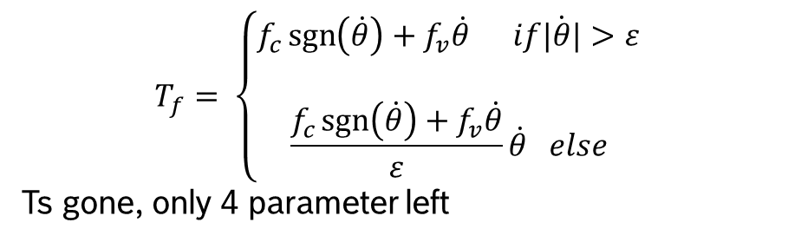
Continues function instead of if-else function
$$T_{f}= \left\{\begin{aligned}f_{c}\operatorname{sgn}\left(\dot{θ}\right)+f_{v}\dot{θ} if\dot{|θ|}&>ε \\ \\ \frac{f_{c}\operatorname{sgn}\left(\dot{θ}\right)+f_{v}\dot{θ}}{ε}\dot{θ} else\end{aligned}\right.$$
Ts gone, only 4 parameter left

Slide 5
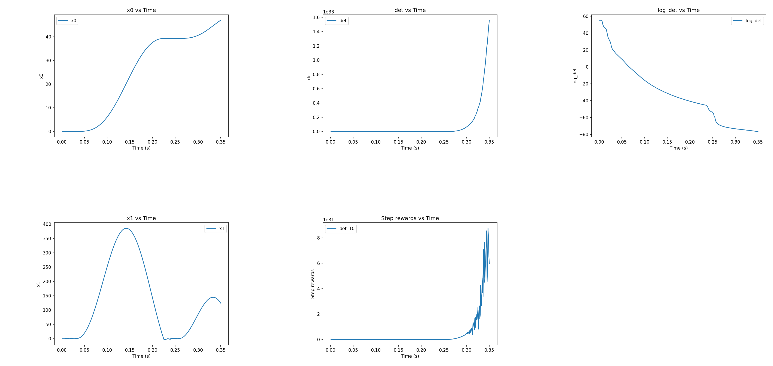
With input u = 1 + sin(2pi*t- pi/2)
Setp reward
Final reward/det 1.558395e+33
-log(det) = -76.429

Slide 6
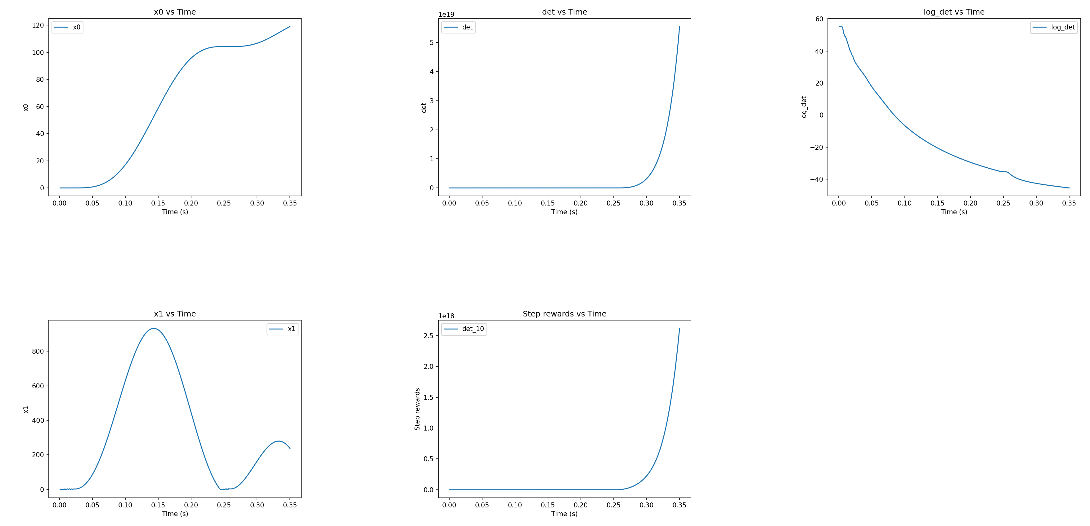
With input u = 2 + 2*sin(2pi*t- pi/2)
Setp reward
Final reward/det 5.543374e+19
-log(det) = -45.462

Slide 7
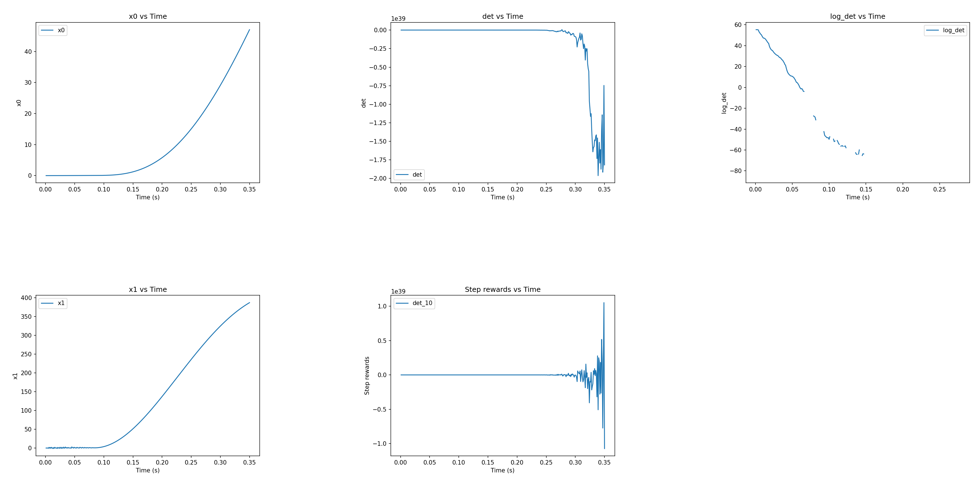
With input u = 2/350 * t
Setp reward
Minus det

Slide 8
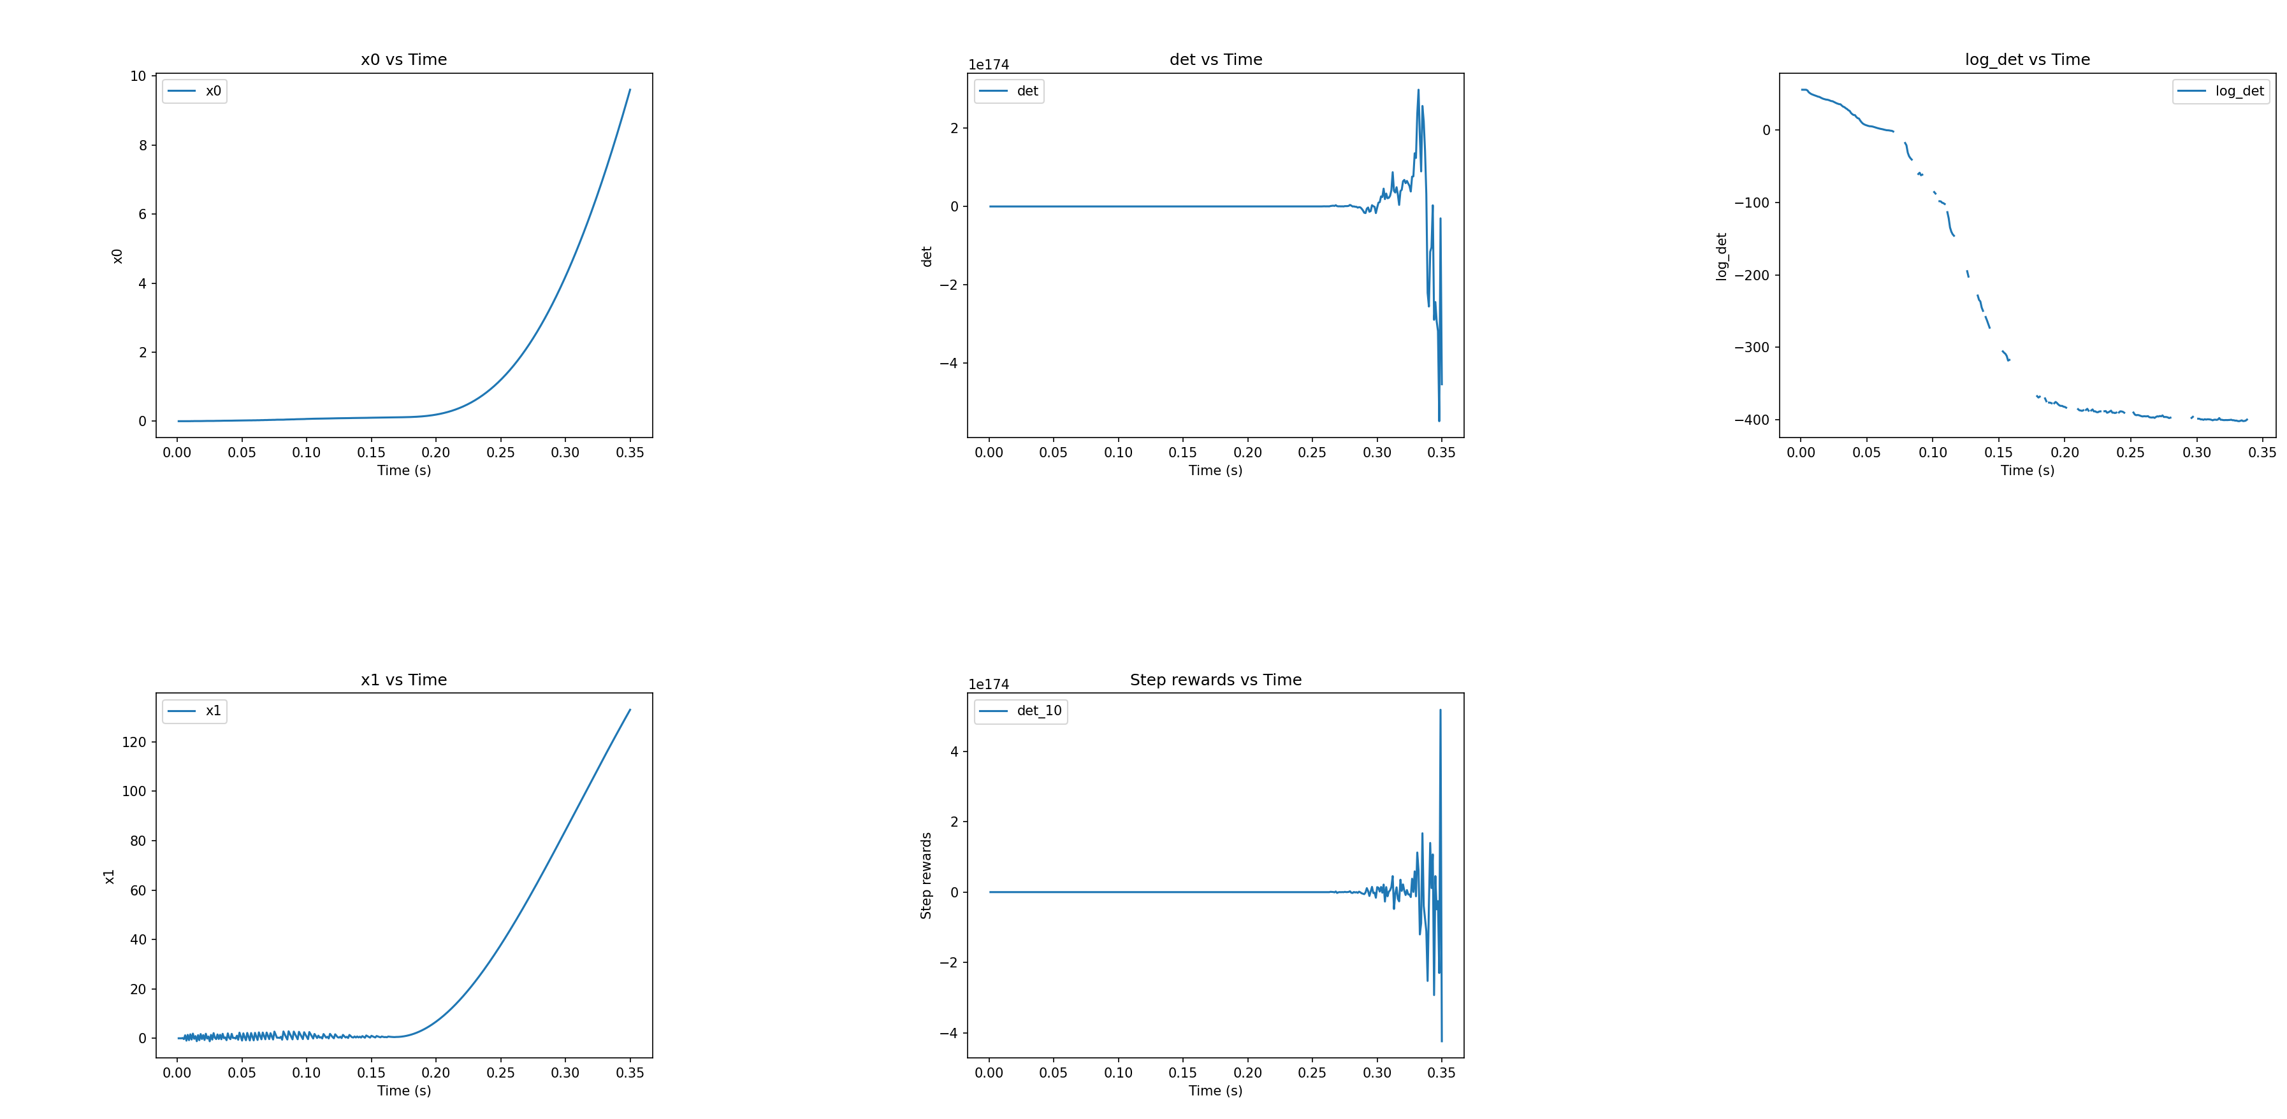
With input u = 1/350 * t
Setp reward
Minus det

Slide 9



Next
Prove the inequality λ i​ (A)+λ 1​ (B)≤λ i​ (A+B)≤λ i​ (A)+λ n​ (B) with Courant-Fircher theorem.
Figure out how to normalize M without the affection of the setp reward and total reward.
Figure out if the initial diagonal matrix infect the sum of setp reward.
For the original script, there is no different with the initiate matrix.

Slide 10
Courant-Fircher theorem

